Slide 1
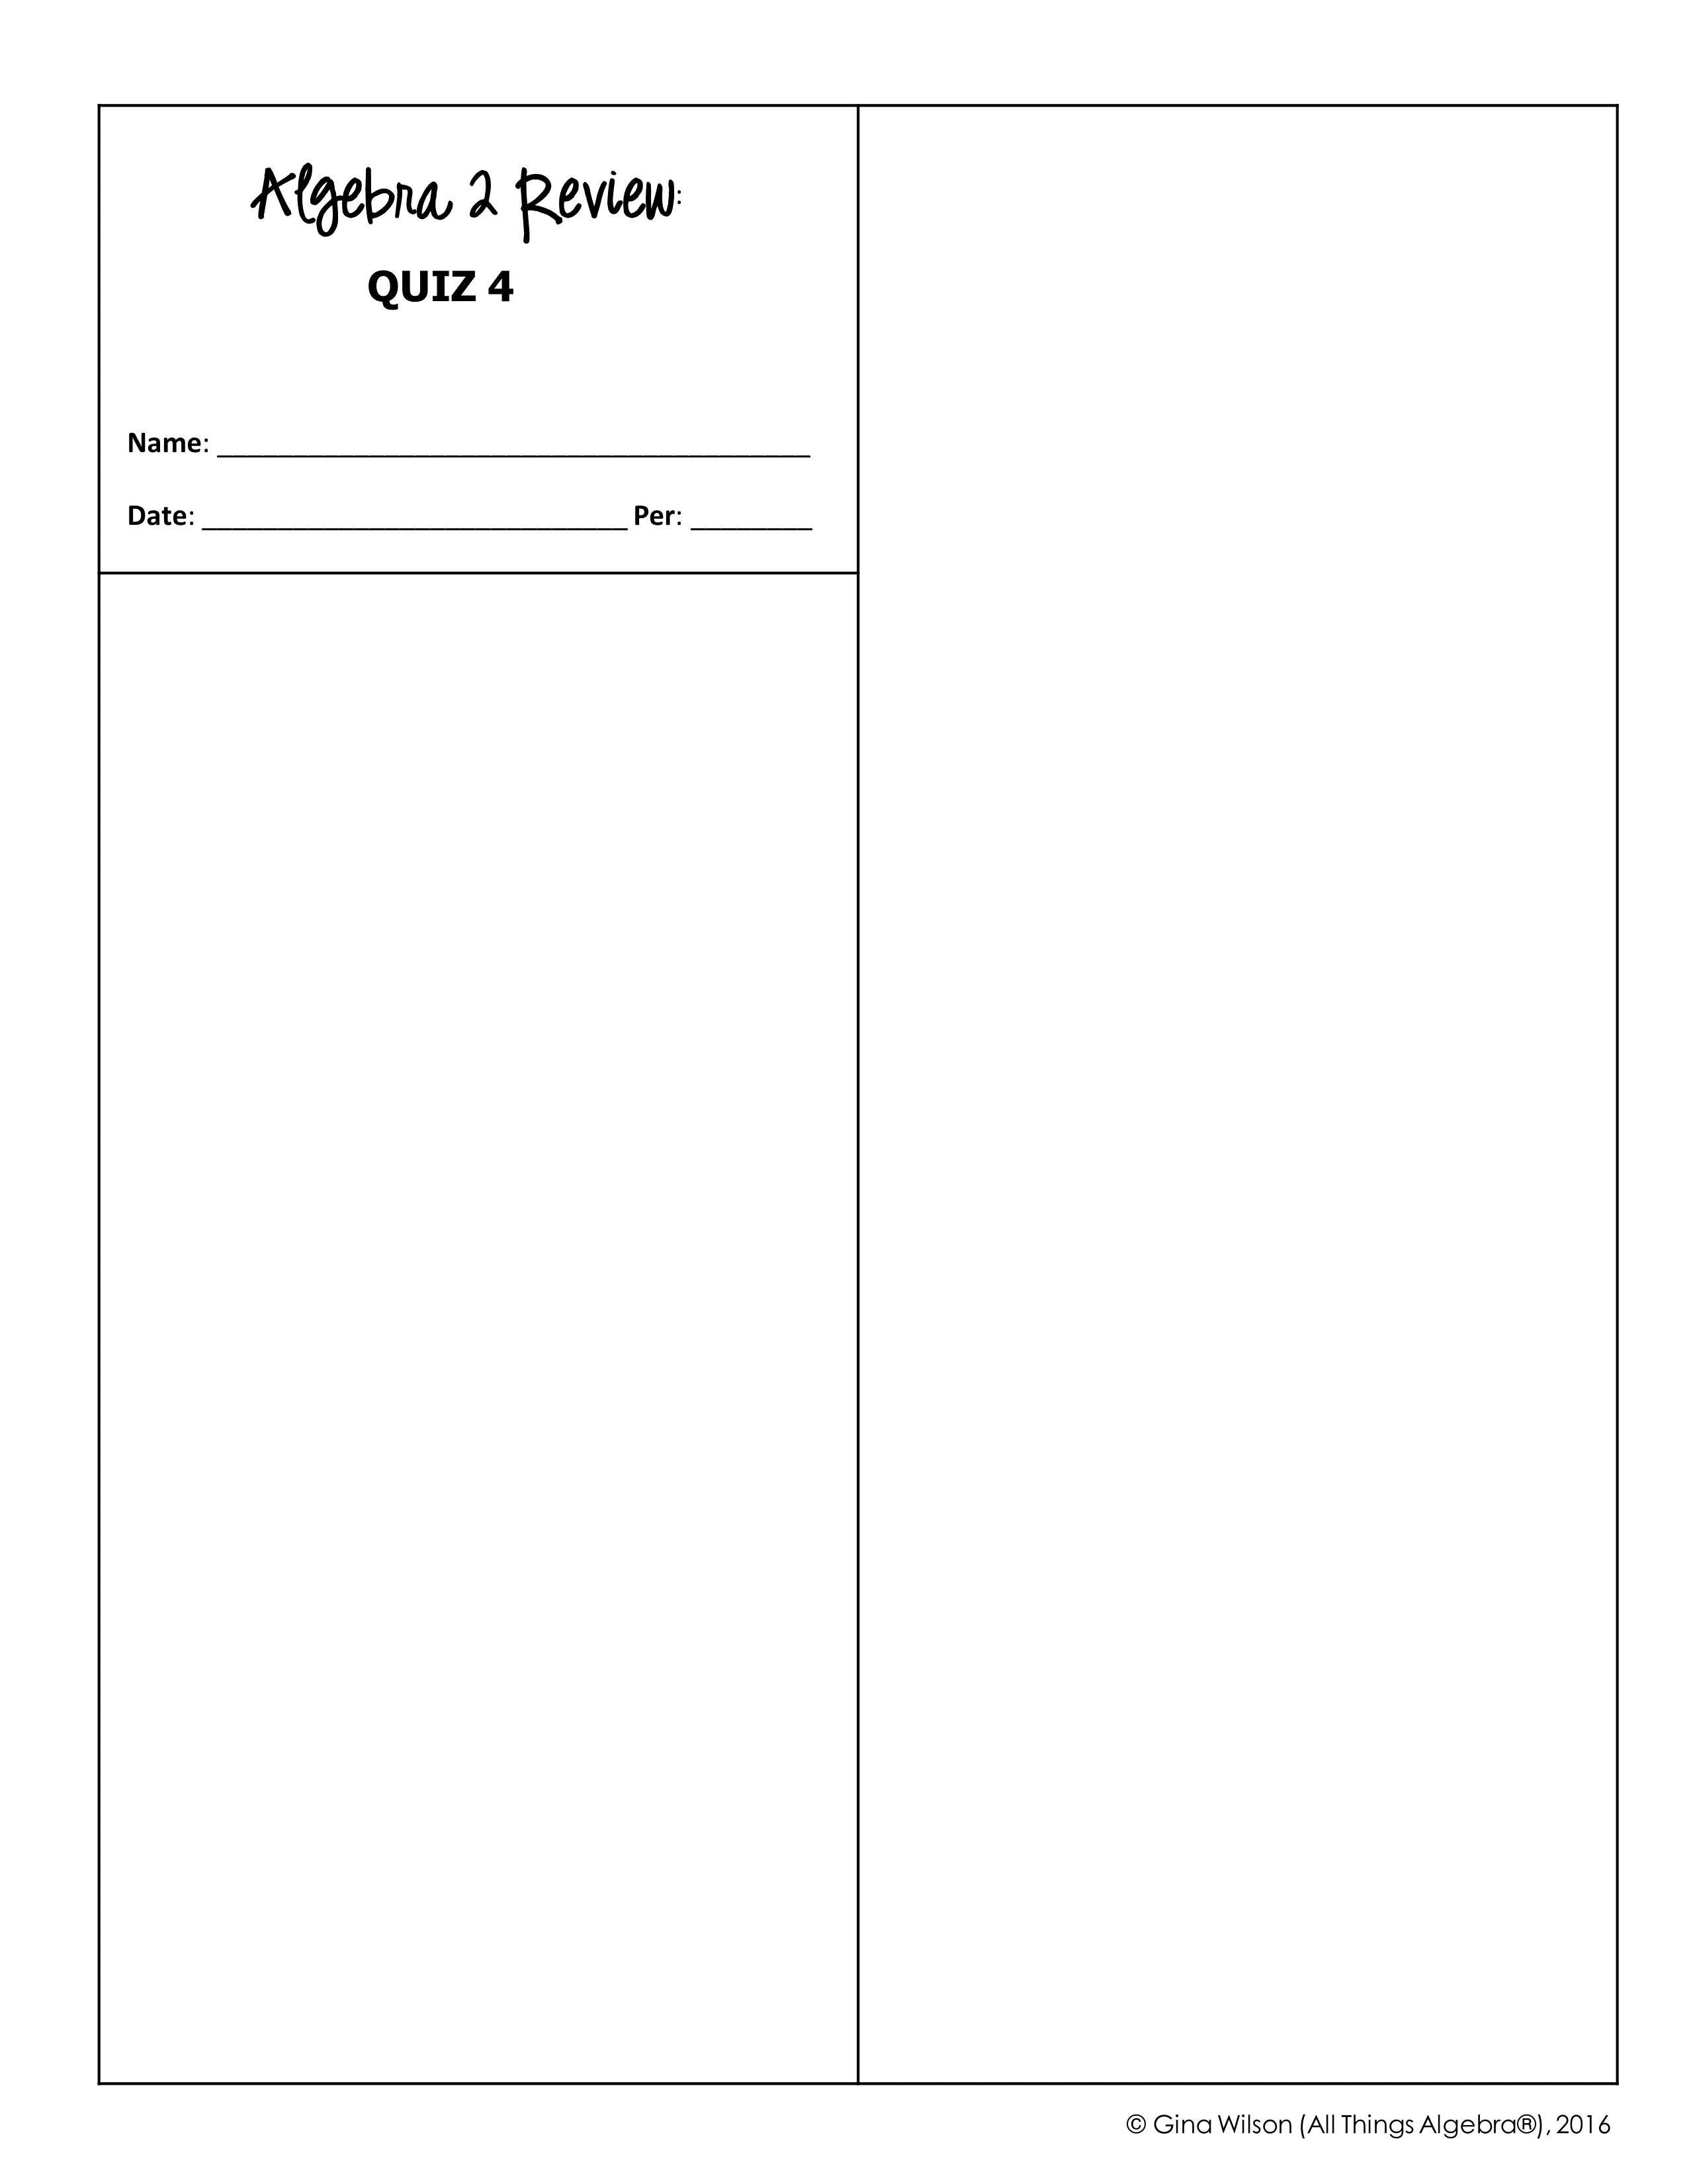
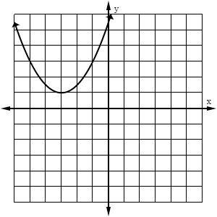
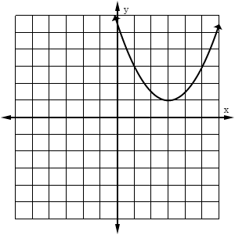
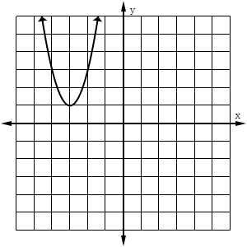
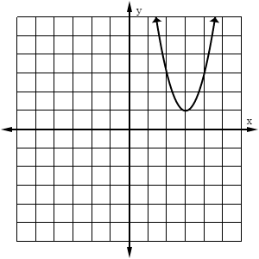
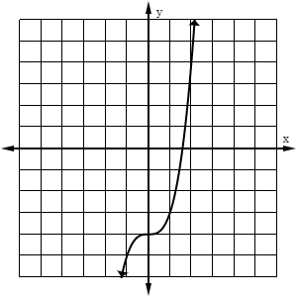
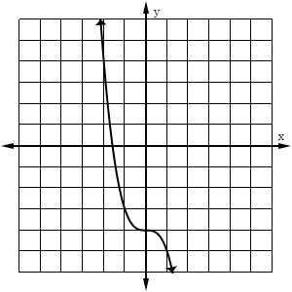
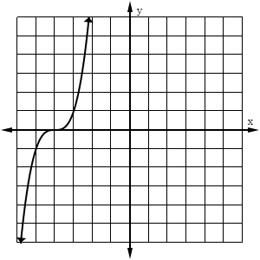
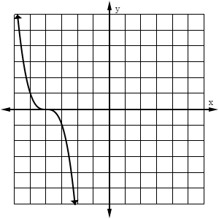
3. Which function has a range of ?
A. C. B. D.
4. The function is increasing through the interval –
A. C. B. D.
1. Which graph best represents the function ?
A.
B.
5. The function is decreasing through the interval(s) –
A. and B. and C. D.
C.
D.
6. Mason translated the function 7 units up and 3 units left. Which equation represents the new function?
A. C. B. D.
2. Which graph represents the function ?
7. What are the turning points of the function ?
A.
B.
A. and B. and C. and D. and
8. For which function is -4 a zero?
C.
D.
A. B. C. D.

Slide 2

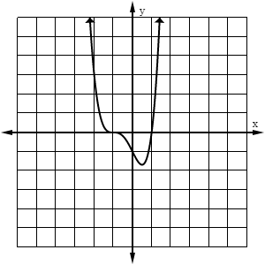
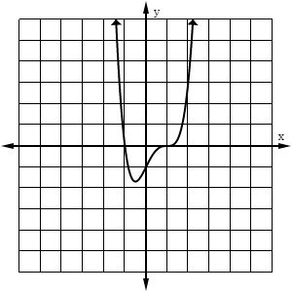
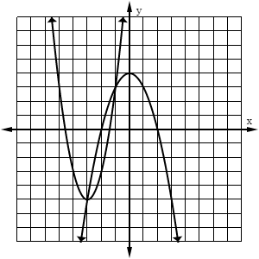
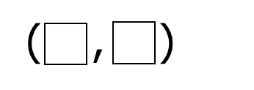
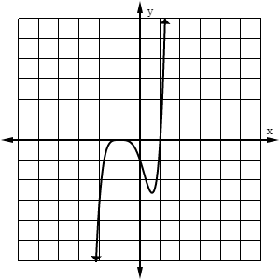
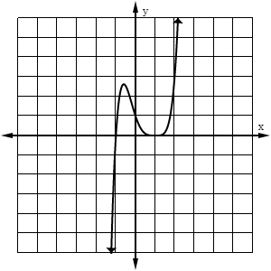

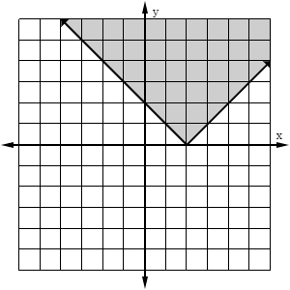
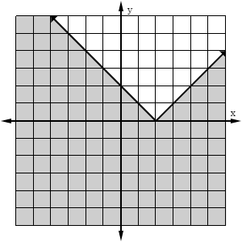
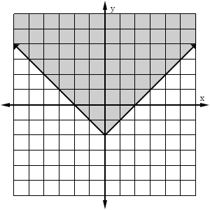
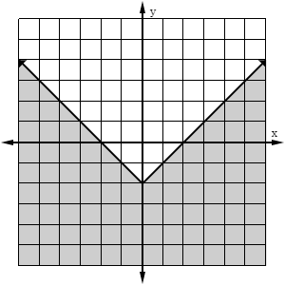
9. A polynomial function has a factor of . Which graph could represent this function?
12. The graph of a system of equations is shown below. Identify a solution to the system.
A.
B.
C.
D.
13. Solve the system of equations:
10. Which statement(s) describe the end behavior ? Check all that apply.
As
As
A. B. C. and D. and
As
As
11. Which graph represents the function ?
14. Solve the system of equations:
A.
B.
C.
D.
A. No Solution B. C. D. and

